Slide 1
Chapter 4 - Basic network firewall topologies and setup

Slide 2
What is a firewall?
A firewall is a device (or software feature) designed to control the flow of traffic into and out-of a network.
In general, firewalls are installed to prevent attacks.

Slide 3
What is an attack?
Someone probing a network for computers.
Someone attempting to crash services on a computer.
Someone attempting to crash a computer
Someone attempting to gain access to a computer to use resources or information.

Slide 4
Edge Firewall
An edge firewall is usually software running on a server or workstation. An edge firewall protects a single computer from attacks directed against it.
Examples of these firewalls are:
Windows Firewall
Symantec End Point Protection
Zone Alarm

Slide 5
Appliance Firewall
An appliance firewall is a device whose sole function is to act as a firewall.
Examples of these firewalls are:
Cisco ASA
Check Point NGFW
Fortinet Fortigate

Slide 6
Network Firewall
Router/Bridge based Firewall
  A firewall running on a bridge or a router protects from a group of devices to an entire network. Cisco has firewall feature sets in their IOS operating system.
Computer-based Network Firewall
  A network firewall runs on a computer (such as a PC or Unix computer). These firewalls are some of the most flexible. Many free products are available including IPFilter (the first package we tried), PF (the current package we are using found on OpenBSD 3.0 and later) and IPTables (found on Linux). Commercial products include: Checkpoint Firewall-1. Apple OSX includes IPFW (included in an operating system you gotta purchase).

Slide 7
Why use a firewall?
Protect a wide range of machines from general probes and many attacks.
Provides some protection for machines lacking in security.

Slide 8
Great first line of defense.
Having a firewall is a necessary evil. It’s like living in a gated community. The gate may stop 99% of unwanted visitors. The locks on your doors stop the remaining 1% .
Don’t let the firewall give you a false sense of security. Harden your machines by turning off services you don’t need.

Slide 9
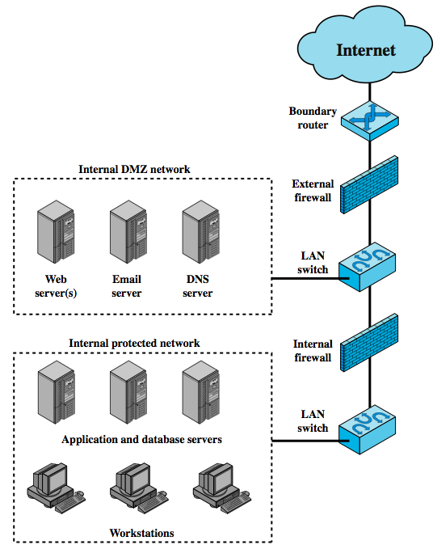
Firewall Locations
Notes:
A firewall is positioned to provide a protective barrier between an external, potentially untrusted source of traffic and an internal network. With that general principal in mind, a security administrator must decide on the location and on the number of firewalls needed. In this section, we look at some common options. Figure 9.3 suggests the most common distinction, that between an internal and an external firewall. An external firewall is placed at the edge of a local or enterprise network. One or more internal firewalls protect the bulk of the enterprise network. Between these two types of firewalls are one or more networked devices in a region referred to as a DMZ (demilitarized zone) network. Systems that are externally accessible but need some protections are usually located on DMZ networks.
The external firewall provides a measure of access control and protection for the DMZ systems consistent with their need for external connectivity. The external firewall also provides a basic level of protection for the remainder of the enterprise network.
In this type of configuration, internal firewalls server three purposes:
1. it adds more stringent filtering capability, compared to the external firewall, in order to protect enterprise servers and workstations from external attack.
2. it provides two-way protection with respect to the DMZ, protecting the remainder of the network from attacks launched from DMZ and protecting DMZ systems from attack from the internal protected network.
3. Multiple internal firewalls can be used to protect portions of the internal network from each other. Figure 6.5 in the text shows a configuration in which the internal servers are protected from internal workstations and vice versa.

Slide 10
Network Defense Configuration:
Double Inline Firewalls
Internet
ScreeningRouter
IDS
Firewall A
VPN
Server
External DNS
IDS
Web Server
E-Commerce
Firewall B
IDS
Protected Internal Network
Database/File Servers
Notes:
Here the Firewall is separate from the Intrusion Detection System. An IDS does not directly filter traffic.
Some Firewalls may include Intrusion Prevention Systems (IPS) which directly filters traffic.
In Unified Threat Management systems they are integrated into one box.

Slide 11
Network Defense Configuration:
Load Balanced Firewalls
Internet
Router
ScreeningRouter
Firewall A
Firewall B
External DNS
IDS
Web Server
E-Commerce
VPN
Server
Protected Internal Network
IDS
Database/File Servers

Slide 12
Network Defense Configuration:
Single T or Multihomed (Separate Zones)
Internet
Router
ScreeningRouter
Firewall
Demilitarized Zone
External DNS
IPS
Web Server
E-Commerce
VPN
Server
Protected Internal Network
Zone
IPS
Database/File Servers
Notes:
The firewall can route to 3 different zones, with different routing rules to each zone.
Multihomed means being able to route to more than 2 zones.

Slide 13
Network Defense Configuration:
Distributed Firewall
Internet
ScreeningRouter
IDS
Firewall A
Firewall
Firewall
Firewall
Firewall
VPN
Server
External DNS
IDS
Web Server
E-Commerce
Firewall B
IDS
Protected Internal Network
Firewall
Database/File Servers
Notes:
Here the Firewall is separate from the Intrusion Detection System. An IDS does not directly filter traffic.
Some Firewalls may include Intrusion Prevention Systems (IPS) which directly filters traffic.
In Unified Threat Management systems they are integrated into one box.

Slide 14
Bastion Hosts
critical strongpoint in network
hosts application/circuit-level gateways
common characteristics:
  runs secure O/S, only essential services
  may require user auth to access proxy or host
  each proxy can restrict services & hosts accessed
  each proxy small, simple, checked for security
  each proxy is independent, non-privileged
  proxy disk use is boot only; hence read-only code
Notes:
A bastion host is a system identified by the firewall administrator as a critical strong point in the network's security. Typically, the bastion host serves as a platform for an application-level or circuit-level gateway. Common characteristics of a bastion host:
• executes a secure version of its operating system, making it a trusted system.
• only essential services are installed on the bastion host. These include proxy applications such as Telnet, DNS, FTP, SMTP, and user authentication.
• may require additional authentication before a user is allowed access to the proxy services, and may require its own authentication before granting user access.
• each proxy is configured to support only a subset of the application’s command set.
• each proxy is configured to allow access only to specific host systems.
• each proxy maintains detailed audit information by logging all traffic, each connection, and the duration of each connection.
• each proxy module is a very small software package specifically designed for network security, hence is easier to check such modules for security flaws.
• each proxy is independent of other proxies on the bastion host, and can be uninstalled without affecting the operation of the other proxy applications.
• generally performs no disk access other than to read its initial configuration file.
• each proxy runs as a nonprivileged user in a private and secured directory on host.

Slide 15
Firewall Topologies
Host-resident firewall: personal firewall and firewall on servers (used alone or part of a defense in-depth)
Screening router: a single router between internal and external networks, e.g., SOHO apps)
Single bastion inline: single firewall device between an internal and external router (stateful or app proxies)
Single bastion T: similar to above but has a 3rd NIC on bastion to a DMZ (for medium to large organizations)
Double bastion inline: DMZ is between (for large organizations)
Distributed firewall configuration
Notes:
We can now summarize the discussion from Sections 9.4 and 9.5 to define a spectrum of firewall locations and topologies. The following alternatives can be identified:
• Host-resident firewall: This category includes personal firewall software and firewall software on servers, used alone or as part of an in-depth firewall deployment.
• Screening router: single router between internal and external networks with stateless or full packet filtering. Typical for small office/home office (SOHO) applications.
• Single bastion inline: single firewall device between an internal and external router (Fig 9.1a) .The firewall may implement stateful filters and/or application proxies. This is the typical firewall appliance configuration for small to medium-sized organizations.
• Single bastion T: Similar to single bastion inline but has a third network interface on bastion to a DMZ where externally visible servers are placed. Again, this is a common appliance configuration for medium to large organizations.
• Double bastion inline: Fig 9.3 illustrates this configuration, where the DMZ is sandwiched between bastion firewalls. This configuration is common for large businesses and government organizations.
• Double bastion T: Fig 6.5 illustrates this configuration. The DMZ is on a separate network interface on the bastion firewall. This configuration is also common for large businesses and government organizations and may be legally required in some cases.
• Distributed firewall configuration: Illustrated in Fig 9.5. This configuration is used by some large businesses and government organizations.

Slide 16
Network Defenses – with Logs
Internet
Router
Security
Mgmt
Syslog
IDS
Firewall
Vendor A
VPN
Server
External DNS
IPS
Web Server
E-Commerce
Firewall Vendor B
IPS
Protected Internal Network
Database/File Servers
Notes:
Notice there is a physically separate network to carry logs (in the best protected companies).

Slide 17
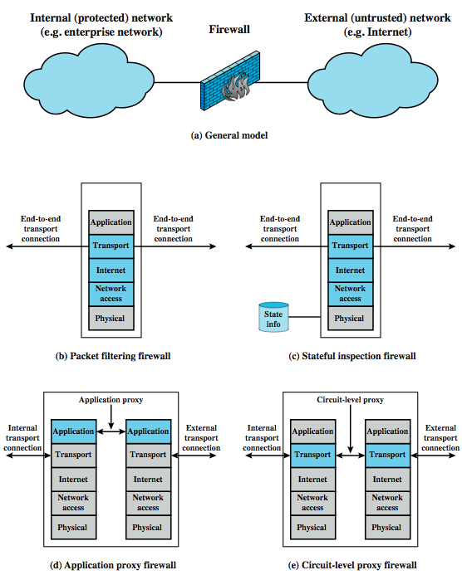
Types of Firewalls
Notes:
A firewall may act as a packet filter. It can operate as a positive filter, allowing to pass only packets that meet specific criteria, or as a negative filter,rejecting any packet that meets certain criteria. Depending on the type of firewall, it may examine one or more protocol headers in each packet, the payload of each packet, or the pattern generated by a sequence of packets. In this section, we look at the principal types of firewalls, which include:
Packet Filtering Firewall: applies a set of rules to each incoming and outgoing IP packet and then forwards or discards the packet (Figure 9.1b).
Stateful Inspection Firewalls: reviews the same packet information as a packet filtering firewall, but also records information about TCP connections (Figure 9.1c). May also keep track of TCP sequence numbers to prevent attacks that depend in some fashion on the sequence number, such as session hijacking.
Application-Level Gateway: acts as a relay of application-level traffic (Figure 9.1d). The user contacts the gateway with the name of the remote host to be accessed. When the user responds and provides a valid user ID and authentication information, the gateway contacts the application on the remote host and relays TCP segments containing the application data between the two endpoints.
Circuit-Level Gateway: or circuit-level proxy (Figure 9.1e) determining which connections will be allowed, and if so, sets up two TCP connections, one between itself and a TCP user on an inner host and one between itself and a TCP user on an outside host. Once the two connections are established, the gateway typically relays TCP segments from one connection to the other without examining the contents.

Slide 18
Firewall
Configurations
terminal
host
firewall
Router Packet Filtering:
Packet header is inspected
Single packet attacks caught
Very little overhead in firewall: very quick
High volume filter
A
A
terminal
host
Stateful Inspection
State retained in firewall memory
Most multi-packet attacks caught
More fields in packet header inspected
Little overhead in firewall: quick
firewall
A
A
A
Notes:
Here the red is the packet header being inspected, and the green is the part of the packet which is not inspected.
When an A is displayed in the firewall, this means that the firewall has state information about each connection and can detect more anomalies.

Slide 19
Packet Filtering Firewall
applies rules to packets in/out of firewall
based on information in packet header
  src/dest IP addr & port, IP protocol, interface
typically a list of rules of matches on fields
  if match rule says if forward or discard packet
two default policies:
  discard - prohibit unless expressly permitted
  forward - permit unless expressly prohibited
Notes:
A packet filtering firewall applies a set of rules to each incoming and outgoing IP packet and then forwards or discards the packet. The firewall is typically configured to filter packets going in both directions (from and to the internal network). Filtering rules are based on information contained in a network packet: source IP address, destination IP address, source and destination transport-level address (port number), IP protocol field, interface (on firewall packet came from or is destined for). One advantage of a packet filtering firewall is its simplicity. Also, packet filters typically are transparent to users and are very fast.
The packet filter is typically set up as a list of rules based on matches to fields in the IP or TCP header. If there is a match to one of the rules, that rule is invoked to determine whether to forward or discard the packet. If there is no match to any rule, then a default action is taken. Two default policies are possible:
• Default = discard: That which is not expressly permitted is prohibited.
• Default = forward: That which is not expressly prohibited is permitted.
The default discard policy is more conservative. Initially, everything is blocked, and services must be added on a case-by-case basis. This policy is more visible to users, who are more likely to see the firewall as a hindrance. The default forward policy increases ease of use for end users but provides reduced security; the security administrator must, in essence, react to each new security threat as it becomes known.

Slide 20
Stateful Inspection Firewall
reviews packet header information but also keeps info on TCP connections
  typically have low, “known” port no for server
  and high, dynamically assigned client port no
  simple packet filter must allow all return high port numbered packets back in
  stateful inspection packet firewall tightens rules for TCP traffic using a directory of TCP connections
  only allow incoming traffic to high-numbered ports for packets matching an entry in this directory
  may also track TCP seq numbers as well
Notes:
A traditional packet filter makes filtering decisions on an individual packet basis and does not take into consideration any higher layer context. A Stateful Inspection Firewalls reviews the same packet information but also records information about TCP connections. In general, when an application that uses TCP creates a session with a remote host, it creates a TCP connection in which the TCP port number for the remote (server) application is a number less than 1024 and the TCP port number for the local (client) application is a number between 1024 and 65535. The numbers less than 1024 are the "well-known" port numbers and are assigned permanently to particular applications (e.g., 25 for server SMTP). The numbers between 1024 and 65535 are generated dynamically and have temporary significance only for the lifetime of a TCP connection. A simple packet filtering firewall must permit inbound network traffic on all these high-numbered ports for TCP-based traffic to occur. This creates a vulnerability that can be exploited by unauthorized users. A stateful inspection packet firewall tightens up the rules for TCP traffic by creating a directory of outbound TCP connections, as shown in Table 9.2 in the text. There is an entry for each currently established connection. The packet filter will now allow incoming traffic to high-numbered ports only for those packets that fit the profile of one of the entries in this directory. A stateful packet inspection firewall reviews the same packet information as a packet filtering firewall, but also records information about TCP connections. Some stateful firewalls also keep track of TCP sequence numbers to prevent attacks that depend in some fashion on the sequence number, such as session hijacking.

Slide 21
Application-Level (Proxy) Gateway
Acts as a relay of application-level traffic
  User contacts gateway with remote host name
  Authenticates themselves
  Gateway contacts application on remote host and relays TCP segments between server and user
Must have proxy code for each application
  May restrict application features supported
  Some services may not be available
More secure than packet filters
But have higher overheads
Notes:
An application-level gateway, also called an application proxy, acts as a relay of application-level traffic. The user contacts the gateway using a TCP/IP application, such as Telnet or FTP, and the gateway asks the user for the name of the remote host to be accessed. When the user responds and provides a valid user ID and authentication information, the gateway contacts the application on the remote host and relays TCP segments containing the application data between the two endpoints. If the gateway does not implement the proxy code for a specific application, the service is not supported and cannot be forwarded across the firewall. Further, the gateway can be configured to support only specific features of an application that the network administrator considers acceptable while denying all other features.
Application-level gateways tend to be more secure than packet filters. Rather than trying to deal with the numerous possible combinations that are to be allowed and forbidden at the TCP and IP level, the application-level gateway need only scrutinize a few allowable applications. In addition, it is easy to log and audit all incoming traffic at the application level.
A prime disadvantage of this type of gateway is the additional processing overhead on each connection. In effect, there are two spliced connections between the end users, with the gateway at the splice point, and the gateway must examine and forward all traffic in both directions.

Slide 22
Circuit-Level Gateway
Sets up two TCP connections, to an inside user and to an outside host
Once connection is established, relays TCP segments from one connection to the other without examining contents
  Hence independent of application logic
  Just determines whether relay is permitted
Typically used when inside users trusted
  May use application-level gateway inbound and circuit-level gateway outbound
  Hence lower overheads
Notes:
A fourth type of firewall is the circuit-level gateway or circuit-level proxy (Figure 9.1e). This can be a stand-alone system or it can be a specialized function performed by an application-level gateway for certain applications. As with an application gateway, a circuit-level gateway does not permit an end-to-end TCP connection; rather, the gateway sets up two TCP connections, one between itself and a TCP user on an inner host and one between itself and a TCP user on an outside host. Once the two connections are established, the gateway typically relays TCP segments from one connection to the other without examining the contents. The security function consists of determining which connections will be allowed.
A typical use of circuit-level gateways is a situation in which the system administrator trusts the internal users. The gateway can be configured to support application-level or proxy service on inbound connections and circuit-level functions for outbound connections. In this configuration, the gateway can incur the processing overhead of examining incoming application data for forbidden functions but does not incur that overhead on outgoing data.

Slide 23
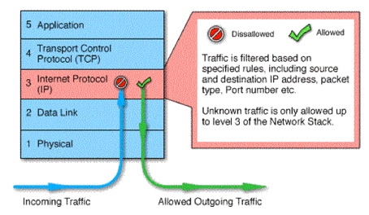
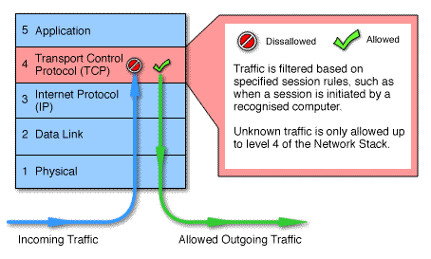
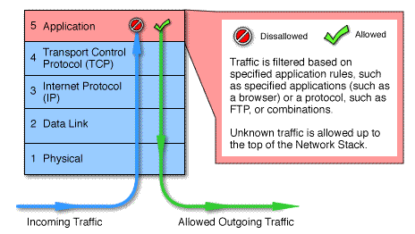
Packet Filtering vs Gateway vs Application-Level Firewall

Slide 24
Research Activity
Discuss with your chosen team
You are required to spend 2 hour to research on the Internet on the different firewall topologies
Prepare a 10 slides presentation to go through each firewall topology and its advantages and disadvantages
Restrict your presentation to 15 mins max

